Slide 1

Today’s Agenda
Introduction to sequential logic
Storage elements: Latches

Slide 2
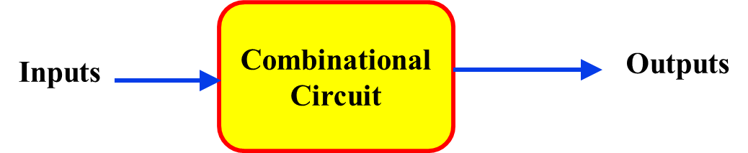
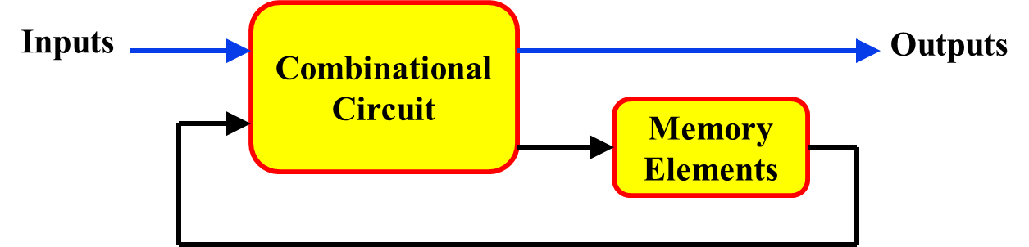
Types of Logic Circuits
Combinational
Sequential
Combination of I/ps + Present states of storage elements
O/p depends on
Combination of I/ps
Elements involved
Logic gates
Logic gates + Storage elements
Feedback present?
No
Yes

Slide 3
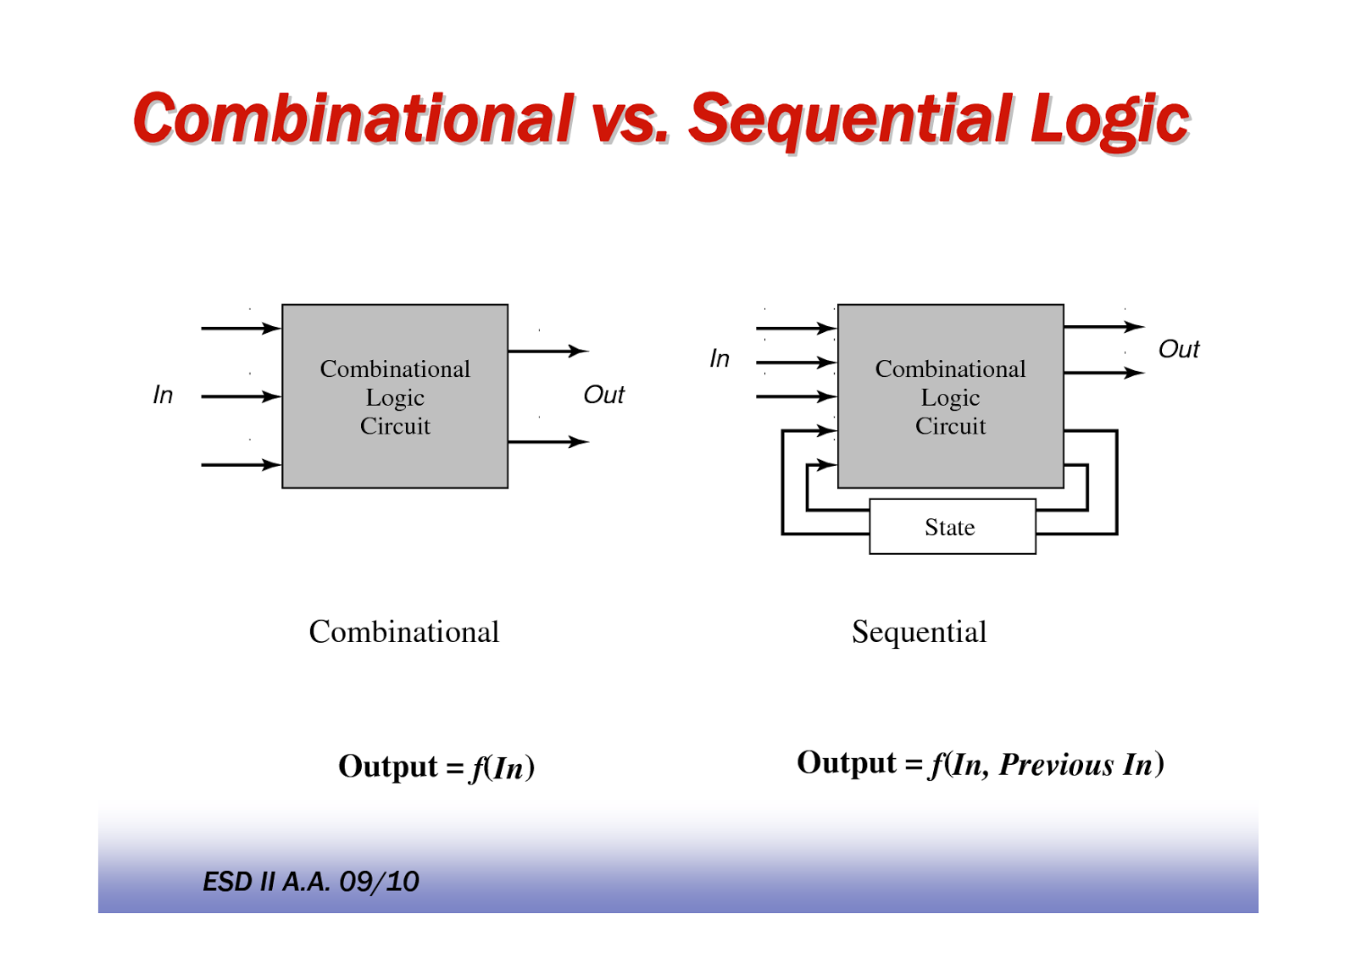
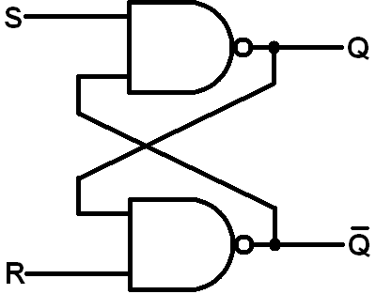
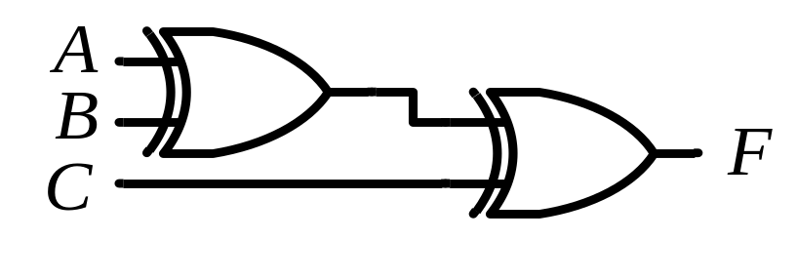
Types of Logic Circuits
Combinational
Sequential
Example
NOT for understanding

Slide 4
Sequential Circuits (Terminology)
Storage elements:
  Devices capable of storing binary information
    Latches
    Flip Flops
State:
  Binary info. stored in the elements at any given time defines state of the sequential circuit at that time
Output:
  The sequential circuit receives binary information from external inputs that together with the present state of the storage elements, determine the binary value of the outputs

Slide 5

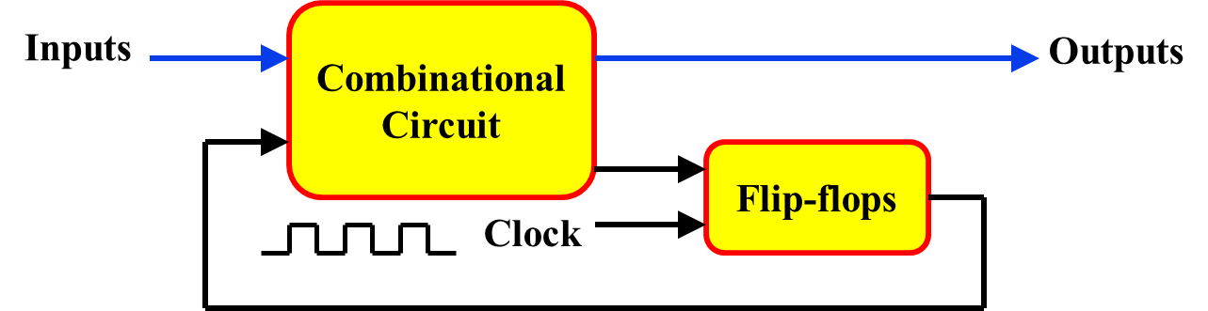
Types of Sequential Circuits
Synchronous
Asynchronous
Changes in state of memory elements
are synchronized by a clock signal
occur in direct response to signal changes on I/p lines
Cct. driven by
Clock
Input events drive the cct.
Time-delay devices
Storage elements
Flip Flops
Design
Easy
Difficult

Slide 6
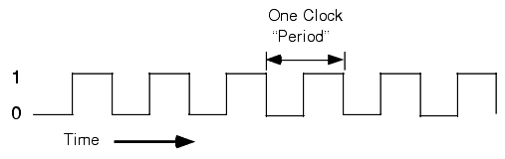
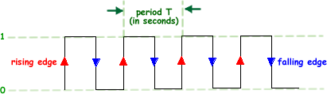
Clock
Periodic train of clock pulses
A clock is a special signal whose O/p continuously alternates between 0 and 1
The time it takes the clock to change from 1 to 0 and back to 1 is called the clock period (or clock cycle time)

Slide 7
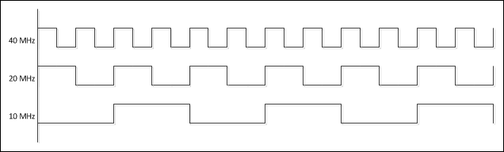
Clock Frequency
The clock frequency is the inverse of the clock period
The unit of measurement for frequency is the hertz (Hz)
How the waveforms of CLK with freq. (given below) look like:
  10 MHz
  20 MHz
  40 MHz

Slide 8
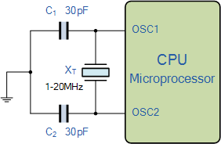
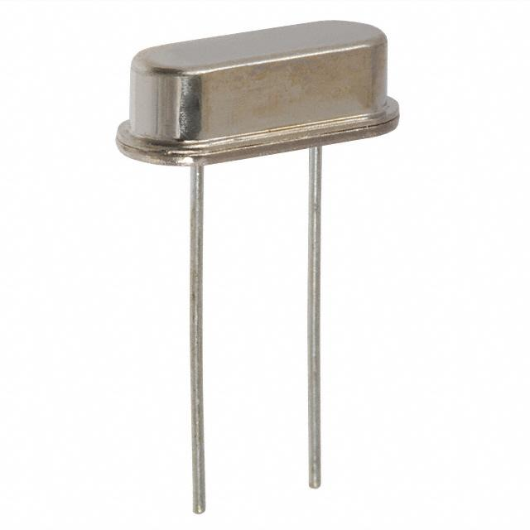
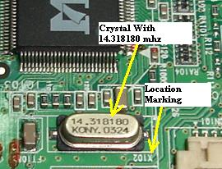
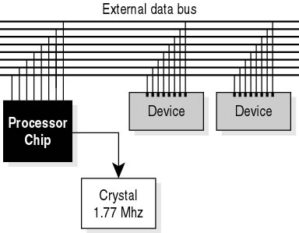
How Clock is Generated?

Slide 9
Role of Clock in Synch. Cct.
CLK affects the storage element at only discrete instants of time

Slide 10
What Exactly is Memory?
A memory should have at least three properties:
  It should be able to hold a value
  You should be able to read the value that was saved
  You should be able to change the value that’s saved
We’ll start with the simplest case, a one-bit memory:
  It should be able to hold a single bit, 0 or 1
  You should be able to read the bit that was saved
  You should be able to change the value. Since there’s only a single bit, there are only two choices:
    ̶ Set the bit to 1
    ̶ Reset, or clear, the bit to 0

Slide 11
Storage Elements(Memory)
Latches
Flip Flops

Slide 12
Latches
Latches are level sensitive storage elements.
They operate based on whether signals are at logic levels0 or 1, not on logic transitions from 0 -> 1 or 1 -> 0.
Latches are not really too useful for synchronous sequential circuits (they are for asynchronous circuits), but form the basis from which flip-flops are built.

Slide 13
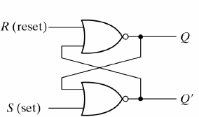
SR Latch (NOR implementation)
Consider the operation of the following circuit:
NOR Gate
Input |  | Output
A | B | F
0 | 0 | 1
0 | 1 | 0
1 | 0 | 0
1 | 1 | 0
Q_{next} = (R + Q’_{current})’
Q’_{next} = (S + Q_{current})’

Slide 14
SR Latch (NOR implementation)
In general (one exception, see below), the outputs are complements of each other (this is why they are labeled Q and Q’
a) When S=1, R=0
the output is Q=1, Q’= 0and the circuit in the set state.
b) When S=0, R=1
the output is Q=0, Q’=1and the circuit in the reset state.
c) When S=0, R=0
the output holds at its previous value (storage).
d) When S=1, R=1
the output is Q=Q’=0which is not desirable.We want to avoid this combination of inputs.

Slide 15
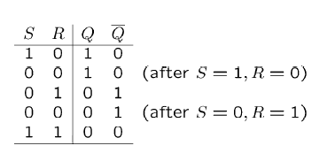
SR Latch (NOR implementation)
Q_{next} = (R + Q’_{current})’
Q’_{next} = (S + Q_{current})’

Slide 16

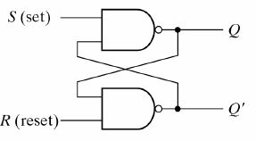
SR Latch (NAND implementation)
NAND Gate
Input |  | Output
A | B | F
0 | 0 | 1
0 | 1 | 1
1 | 0 | 1
1 | 1 | 0
Q_{next} = (S . Q’_{current})’
Q’_{next} = (R.Q_{current})’

Slide 17
SR Latch (NAND implementation)
In general (one exception, see below), the outputs are complements of each other (this is why they are labeled Q and Q’.
a) When S=0, R=1
the output is Q=1, Q’=0and the circuit in the set state.
b) When S=1, R=0
the output is Q=0, Q’=1and the circuit in the reset state.
c) When S=1, R=1
the output holds at its previous value (storage).
d) When S=0, R=0
the output is Q= Q’=1which is not desirable.
So, it works similar to the NOR implementation, but the input values are reversed for each of the different cases.

Slide 18
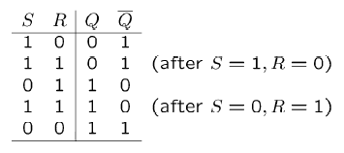
SR Latch (NAND implementation)
Q_{next} = (S . Q’_{current})’
Q’_{next} = (R.Q_{current})’

Slide 19
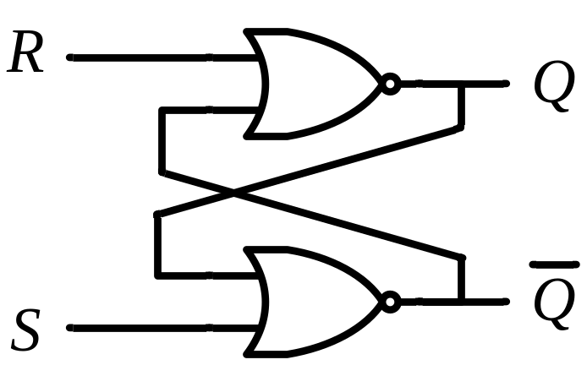
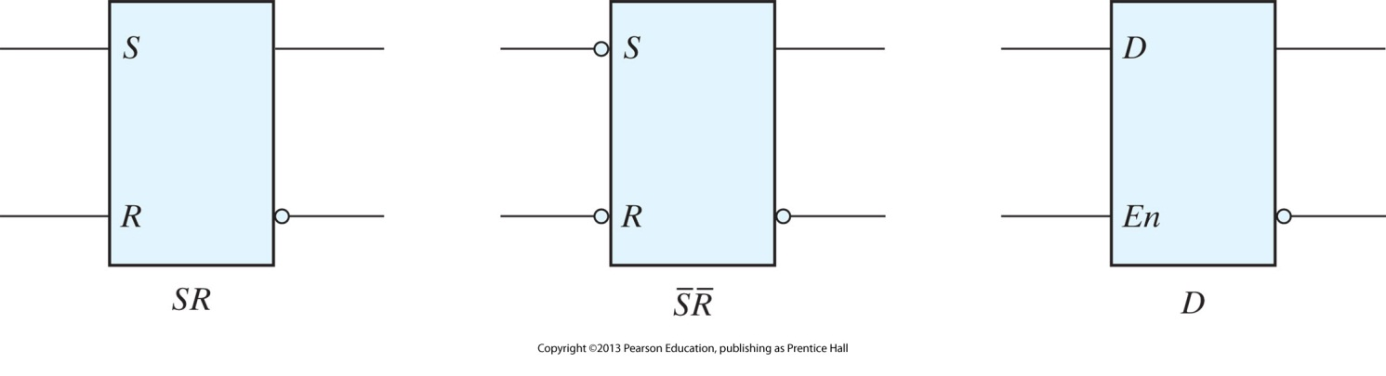
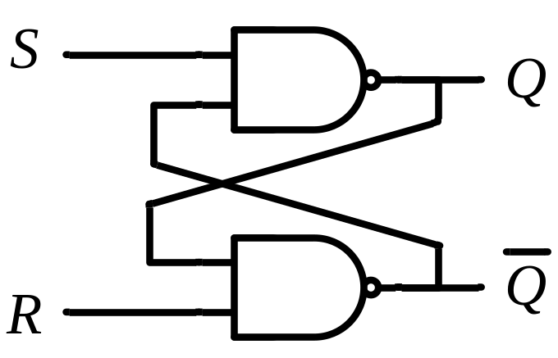
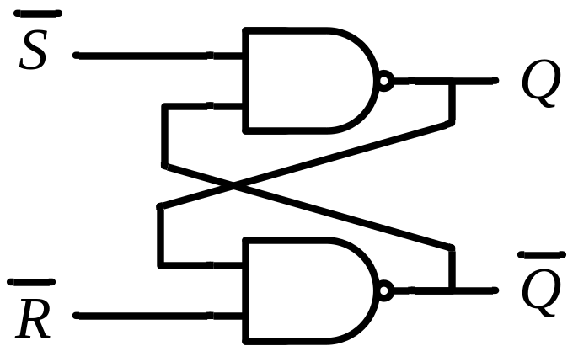
Latch Graphical Representations
S R | Q
0 0 | Q_{current}
0 1 | 0
1 0 | 1
1 1 | Q=Q’=0
No change
Reset
Set
Invalid
S R | Q
0 0 | Q=Q’=1
0 1 | 1
1 0 | 0
1 1 | Q_{current}
Invalid
Set
Reset
No change
Setting and resetting occur with a logic-0 signal

Slide 20
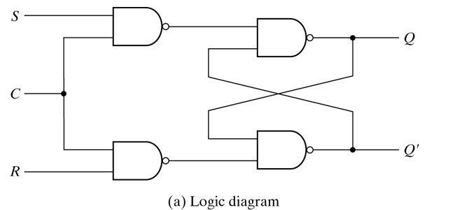
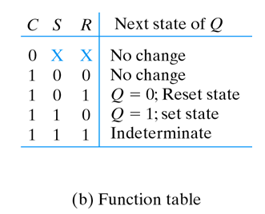
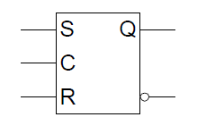
S-R Latch with control input

Slide 21
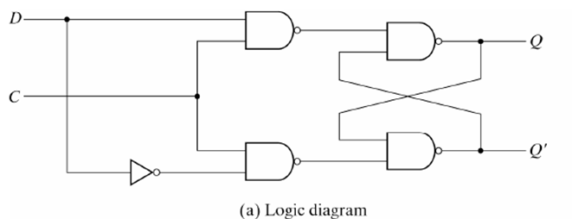
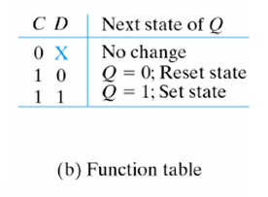
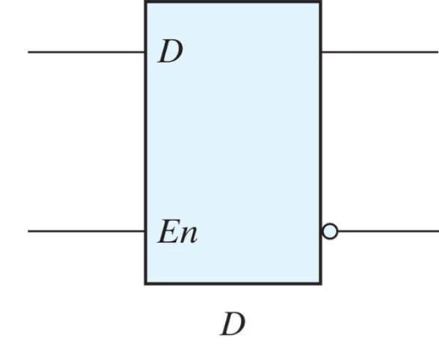
D-Latch

Slide 22
D Latch (D – Data)
Timing Diagram
C
D
C D | Q
0 x | Q₀
1 0 | 0
1 1 | 1
Q
No change
Reset
Set
t
Output may change
Sensitive to levels
Level triggered
C

